Slide 1
National Grid -LondonLab (MAM)
April 2021
Market Fundamentals For internal use only

Slide 2
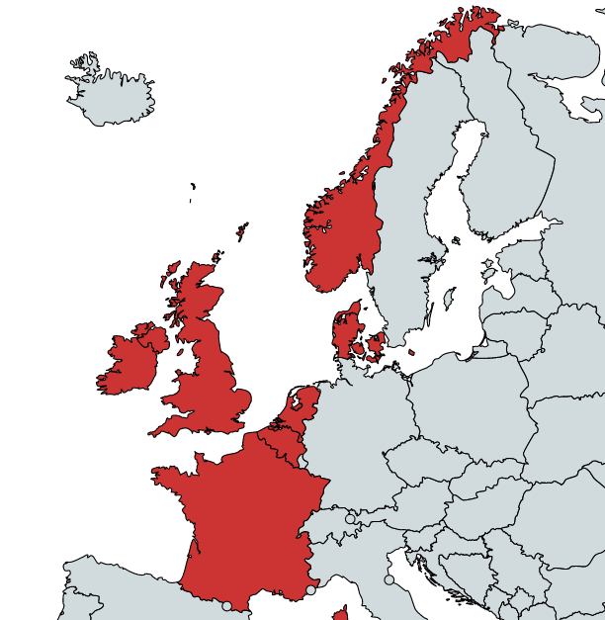
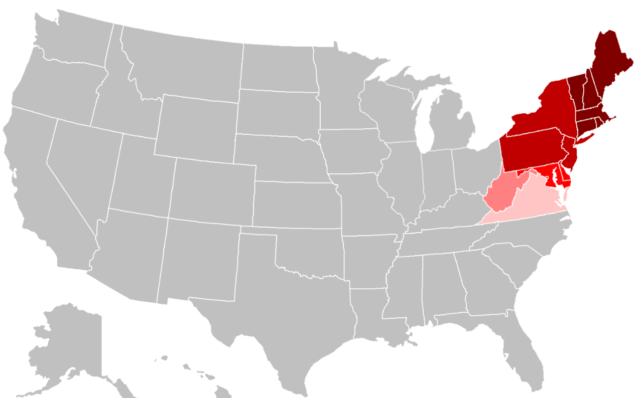





What do National Grid do?
Generation
Transmission
Distribution and Retail
Nuclear
Thermal
Renewables
Transmission
Distribution
Electricity Retail
Energy Services
Non Energy Services

Slide 3
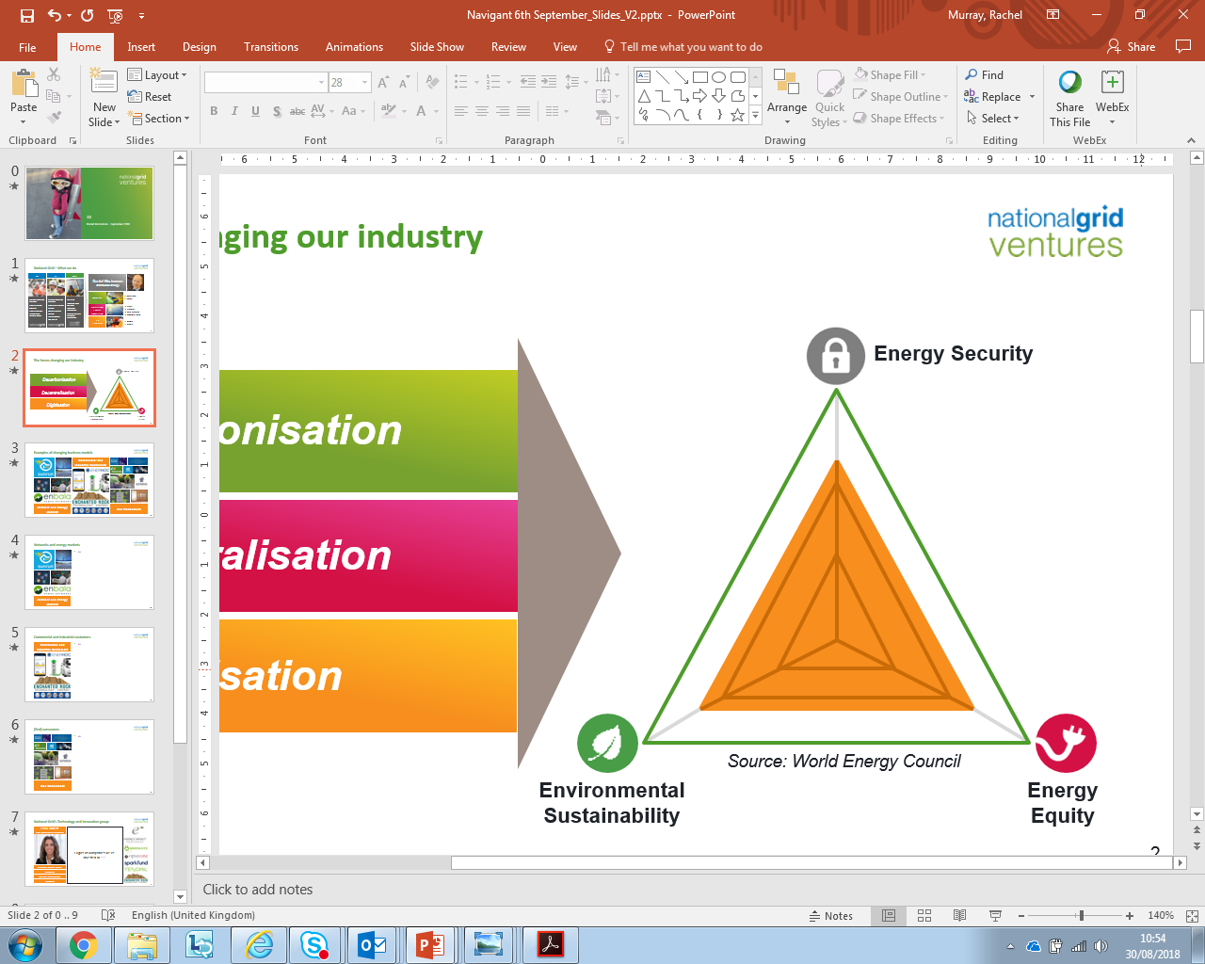
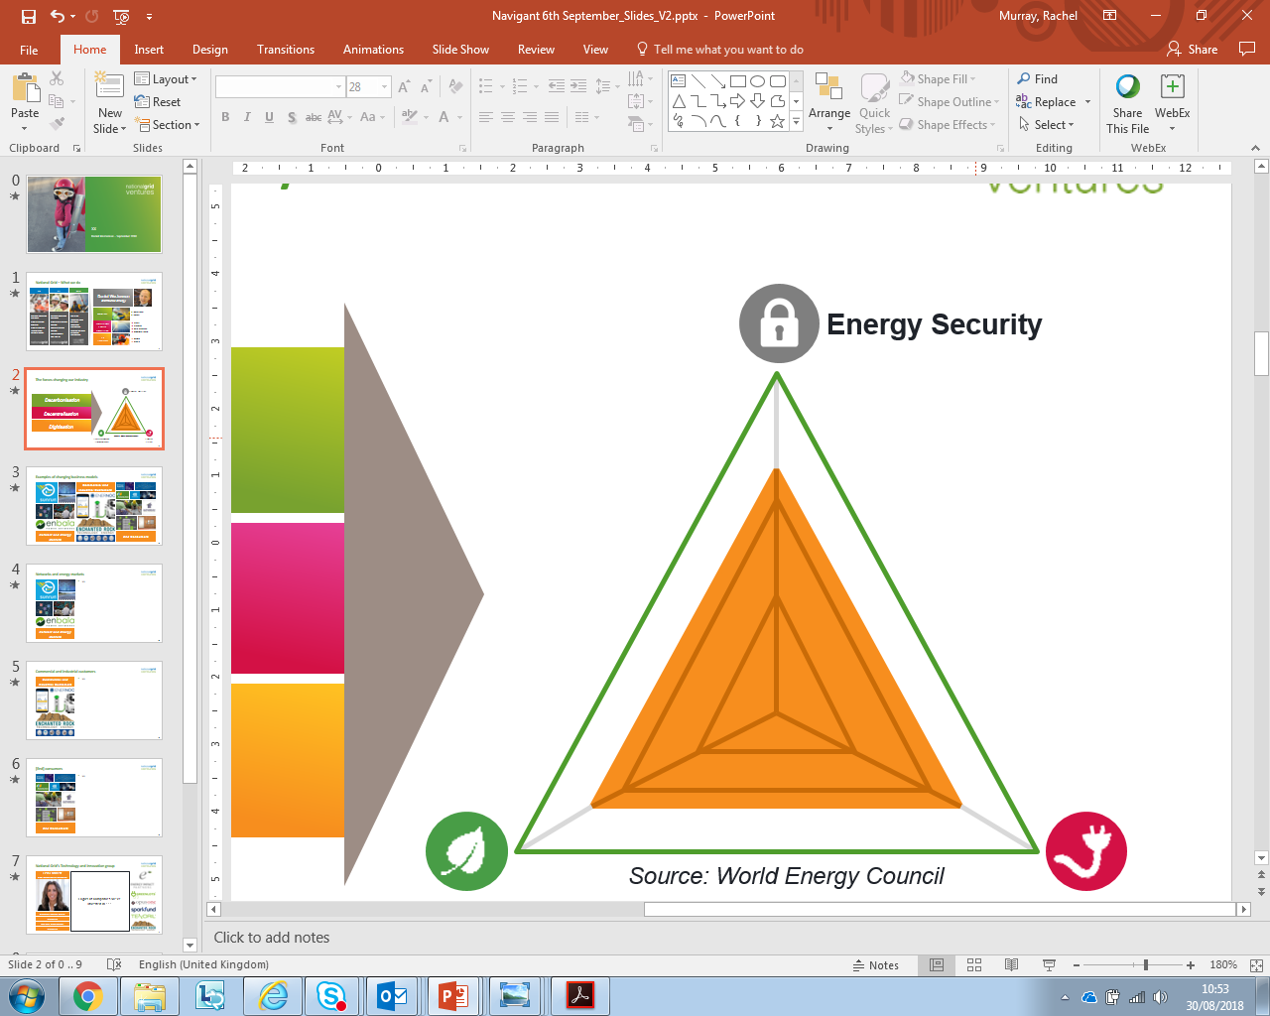
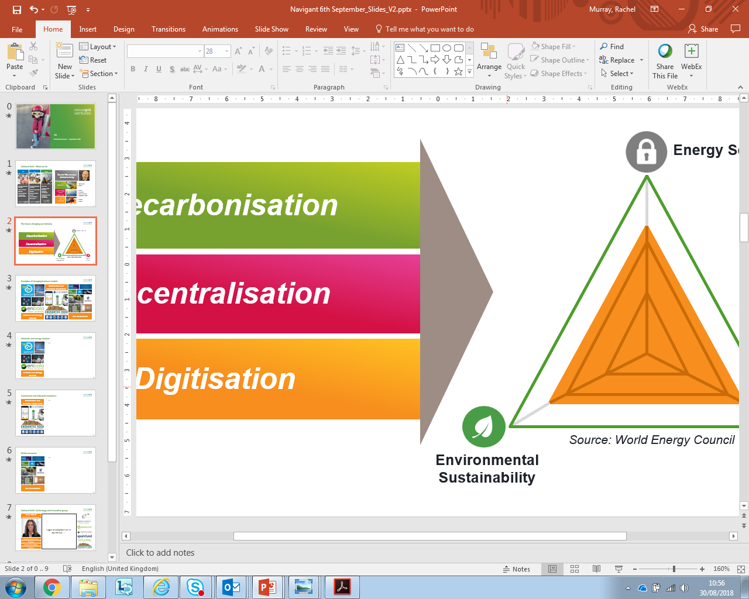


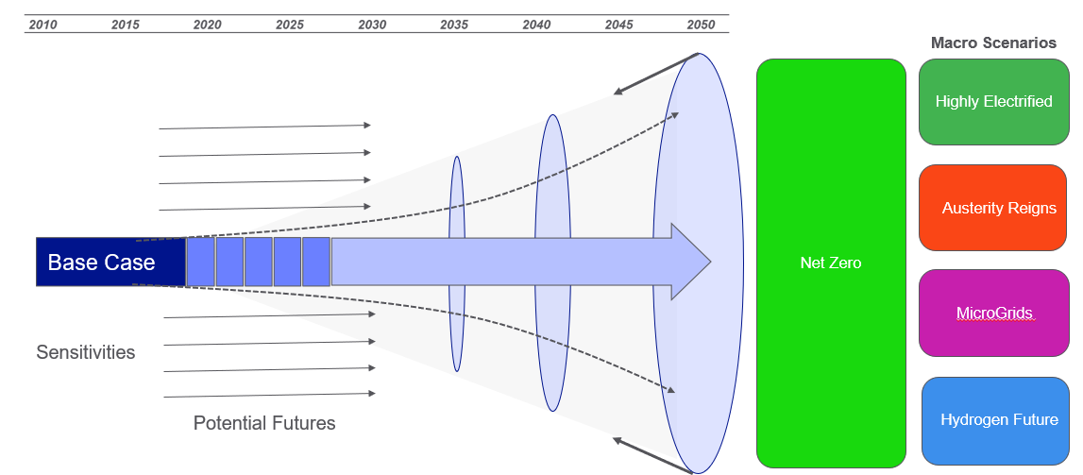






Market Fundamentals: an objective, cost-driven view of the market
Gather data
Refine
Base Case
Work shops
Key beliefs
Model
SECURITY OF SUPPLY
AFFORDABILITY
SUSTAINABILITY

Slide 4
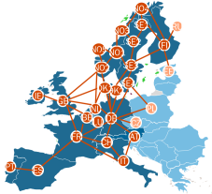
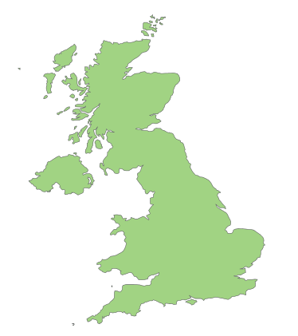
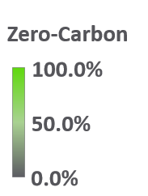
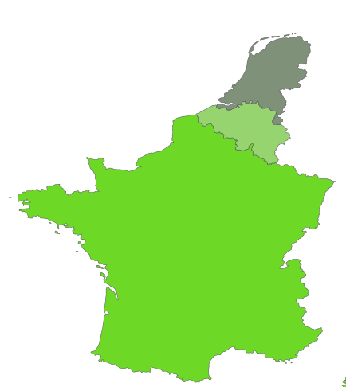
Project Overview: A Greener Europe
Interconnectors play a crucial role in reducing carbon emissions by moving green energy across Europe.
We would like to understand :
How much green energy will we import from Europe in the short term?
What are carbon savings being made in GB in the short term?
How green will Europe be in 2025?

Slide 5
Milestones and Timelines
Project Kick-off
Student Engagement
Project Delivery
Intro meeting
EU market deep-dive session
Finalising data & objectives
AOB to support background knowledge
Students ‘own time’ to lead on project delivery
We will be available to answer any queries/clear any doubts
Delivery of data-driven model to be used by the Market Fundamentals team
Final presentation to be delivered to the Market Fundamentals team
April 2021
May-June 2021

Slide 6
Available resources
Model & project specifications : Refer to project proposal
Data: Look at ENTSO-E,ELEXON and NORDPOOL to learn more about EU energy data
Market Knowledge: Knowledge sessions to be held by the Market Fundamentals team
Further readings: Europa, IEA, World Bank, ENTSO-E TYNDP reports to understand more about EU power policies & targets

